Slide 2
Generative AI & Azure OpenAI
Hamit Sehjal
Majd Al Mnayer

Slide 3
Topics
What is Generative AI?
What are Tokens?
What is Prompt Engineering?
What is Azure OpenAI?
How to use Azure OpenAI

Slide 4
What is Generative AI?

Slide 5
Introduction to Generative AI
Definition of Generative AI
Comparison with traditional AI
Core functionalities and capabilities
Notes:
Generative AI refers to algorithms that can generate new content or data that's never been seen before. Unlike traditional AI, which analyzes and learns from existing data, generative AI can create novel outputs, from text to images and beyond.

Slide 6
Examples of Generative AI
ChatGPT
DALL-E 3
Google Gemini
OpenAI Sora
Midjourney
Notes:
Various examples of generative AI include ChatGPT for text generation, DALL-E 3 for image creation, Google Gemini and OpenAI Sora for advanced AI functionalities, and Midjourney for unique AI-driven journeys.

Slide 7
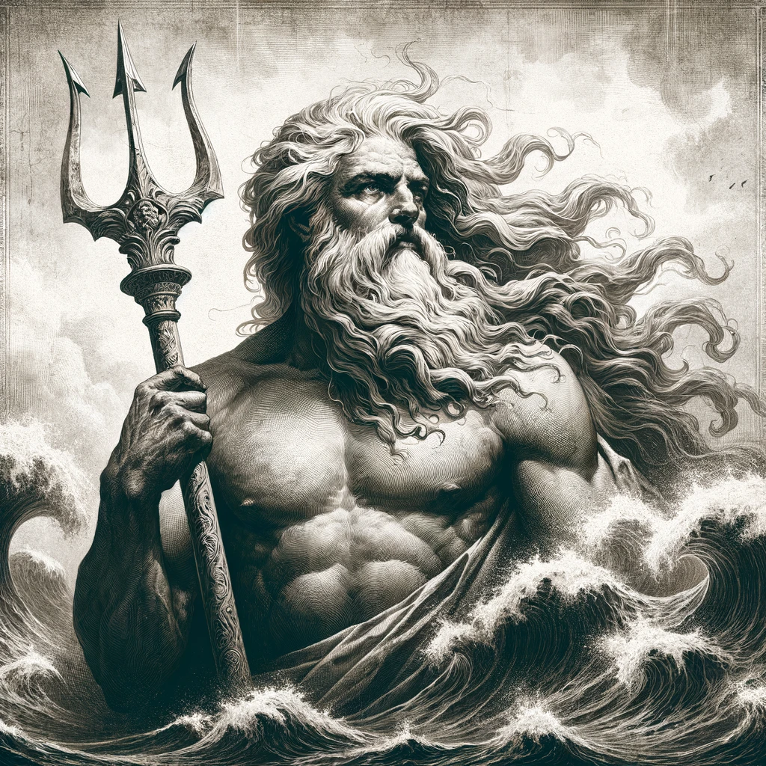
DALL-E 3 - Example
Prompt: Create an image of the Greek god Poseidon, accurately showcasing how he is depicted in the history books.

Slide 8

Sora - Example
Prompt: A stylish woman walks down a Tokyo street filled with warm glowing neon and animated city signage. She wears a black leather jacket, a long red dress, and black boots, and carries a black purse. She wears sunglasses and red lipstick. She walks confidently and casually.

Slide 9

Midjourney - Example
Prompt: A boy with a stick.

Slide 10
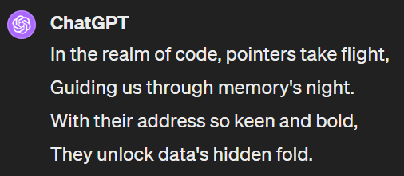
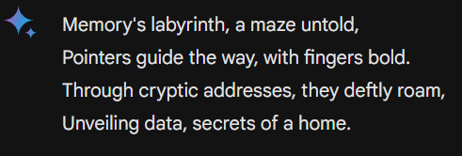
ChatGPT / Gemini - Example
Prompt: Generate a 4-line Poem about pointers.

Slide 11
Applications Across Industries
Healthcare
Entertainment
Marketing
Customer Service
Notes:
Various examples of generative AI include ChatGPT for text generation, DALL-E 3 for image creation, Google Gemini and OpenAI Sora for advanced AI functionalities, and Midjourney for unique AI-driven journeys.

Slide 12
What is Prompt Engineering?

Slide 13
The Role of Prompts
Definition
Importance of prompt engineering in AI
Impact on the output quality and relevance
Notes:
Prompt engineering is the art of crafting queries or commands that guide AI to produce desired outcomes. The quality of your prompt significantly influences the AI's output, making it a crucial skill in AI interactions.

Slide 14
Prompt Do’s
Be concise
Be specific
Reiterate most important steps
Notes:
Imagine telling an AI, 'Close the door.' Without context, the AI might not act as expected. Our skit will show how specifying 'close the door on the right, right now, quietly' guides the AI to perform precisely.

Slide 15
What are Tokens?

Slide 16
Understanding Tokens
Definition of tokens in AI
How prompts are broken down into tokens
Each token as a unit of context
Notes:
In AI, tokens are the building blocks of communication. They can be words, punctuation, or any piece of meaningful data. Understanding tokens helps us better design prompts and interpret AI behaviors.

Slide 17
Importance of Tokens
Role in understanding and generating responses
Influence on AI’s performance and accuracy
The official pricing method of AI models
Notes:
Each token provides context that shapes AI's responses. Their significance extends beyond simple words or characters; they encapsulate meaning and intent, directly influencing AI's effectiveness.

Slide 18
Example – Prompt
Prompt: Write a funny poem!

Slide 19
Example - Tokens
“Write”: A verb that directs an action.
“a”: Helping to specify the task in this context.
“funny”: Adjective, descriptor that helps the AI understand the style.
“poem”: Specifies the type of the content to be generated.
“!”: Provides context regarding tone or urgency of the prompt.
Notes:
Each token provides context that shapes AI's responses. Their significance extends beyond simple words or characters; they encapsulate meaning and intent, directly influencing AI's effectiveness.

Slide 20
What is Azure OpenAI?

Slide 21
Overview of Azure OpenAI
Introduction to Azure OpenAI
Key features and capabilities
Notes:
Azure OpenAI combines Microsoft's cloud infrastructure with OpenAI's cutting-edge models. It offers robust features for creating and deploying AI models, including GPT and DALL-E 3.

Slide 22
Customization and Applications
Customizing GPT models
Creating DALL-E 3 models
Applications in business and research
Notes:
Azure OpenAI's flexibility allows for the customization of GPT models to suit specific needs, creation of DALL-E 3 models for image generation, and various applications ranging from business solutions to academic research.

Slide 23
How to use Azure OpenAI

Slide 24
Getting Started with Azure OpenAI
Setting up an Azure account
Accessing OpenAI services
Notes:
To start using Azure OpenAI, you'll need an Azure account. Once set up, you can access a range of OpenAI services, tailor them to your requirements, and integrate AI capabilities into your projects.

Slide 25
Example Code and Implementation
This slide layout uses Consolas, a monotype font which is ideal for showing software code.

Slide 26
Install Dependencies
npm install openai
npm install @azure/openai

Slide 27
Import and Setup
const OpenAI = require("@azure/openai");
const {OpenAIClient, AzureKeyCredential} = OpenAI;
const client = new OpenAIClient(
AZURE_OPENAI_ENDPOINT,
new AzureKeyCredential(AZURE_OPENAI_KEY)
);

Slide 28
Import and Setup
const messages = [
{
role: "system",
content: system_prompt,
},
{
role: "user",
content: user_prompt,
},
];

Slide 29
Import and Setup
// What you named your model in Azure OpenAI Studio
const deploymentName = OPENAI_DEPLOYMENT_NAME;
// Communicate with the model const result = await client.getChatCompletions(
deploymentName, messages, {
maxTokens: max_tokens, // 1 - 3500
temperature: temp, // 0.1 - 1
});
return result.choices[0].message.content;

Slide 30
Demo
Majd Al Mnayer

Slide 31
Demo
Hamit Sehjal

Slide 32
Thank You!

